Slide 1


Scientific Machine Learning
Lecture 6: From DNNs to PINNs
孟旭辉
数学与统计学院数学与应用学科交叉创新研究院
办公室：欣苑2栋111室
Email：xuhui_meng@hust.edu.cn
https://github.com/XuhuiM/SciML-Course
3/22/2024

Slide 2
Contents
Overview on ODEs/PDEs
From DNN to physics-informed neural networks (PINNs)

Slide 3
Contents
Overview on ODEs/PDEs
From DNN to physics-informed neural networks (PINNs)

Slide 4
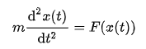
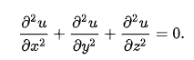
ODEs/PDEs
Partial differential equation (PDE) is an equation which imposes relations between the various partial derivatives of a multivariable function.
Ordinary differential equations form a subclass of partial differential equations, corresponding to functions of a single variable.

Slide 5
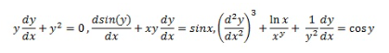

Linear and nonlinear equations
A differential equation without nonlinear terms of the unknown function y and its derivatives is known as a linear differential equation
y cannot have higher index terms such as y², y³, and derivative multiples
$${\left(\frac{dy}{dx}\right)}^{2},\frac{dy}{dx}\left(\frac{d^{2}y}{dx^{2}}\right),…$$
y cannot contain non-linear terms such as
$${\left(y\right)}^{2}, sin\left(y\right),ln⁡(y)…$$

Slide 6
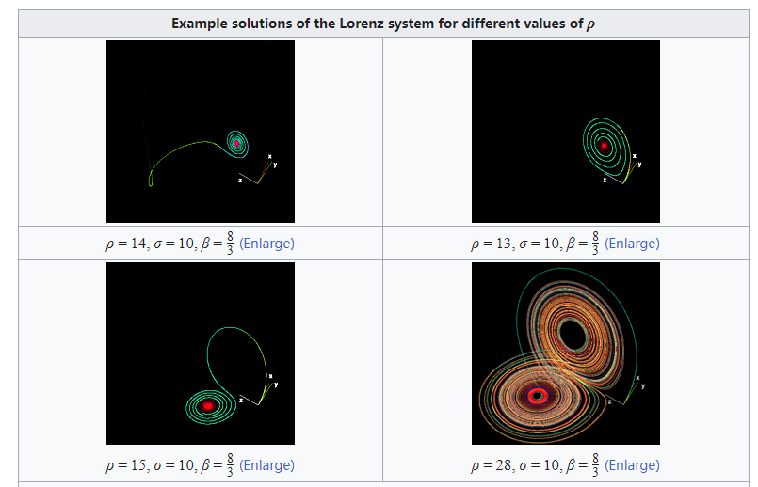
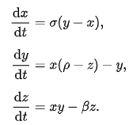
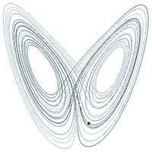
ODE problems: Lorenz system
A sample solution in the Lorenz attractor when ρ = 28, σ = 10, and β = 8/3
From wiki

Slide 7
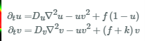
ODE problems: Dynamic systems
https://www.lanevol.org/resources/gray-scott

Slide 8
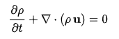
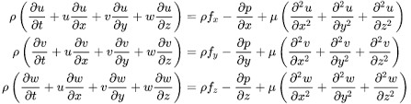
Navier-Stokes equations: Fluid dynamics

Slide 9
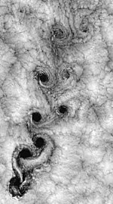
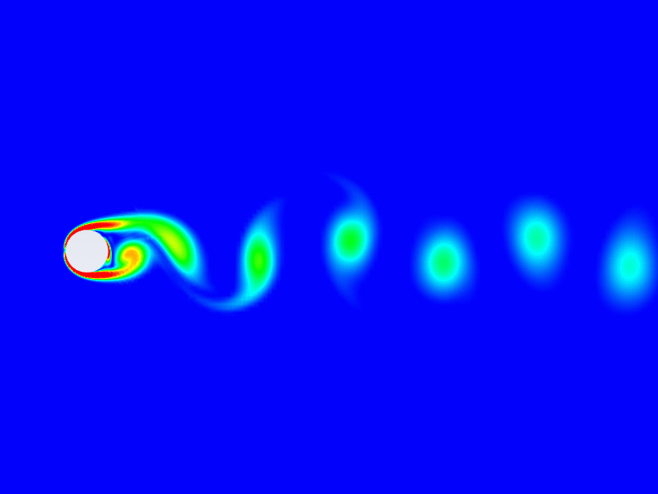
Navier-Stokes equations: Flow past cylinder
From wiki

Slide 10

Navier-Stokes equations: Rayleigh-Taylor instability
Psychedelic Engineering (HD video of a simulation of the Rayleigh-Taylor instability)

Slide 11
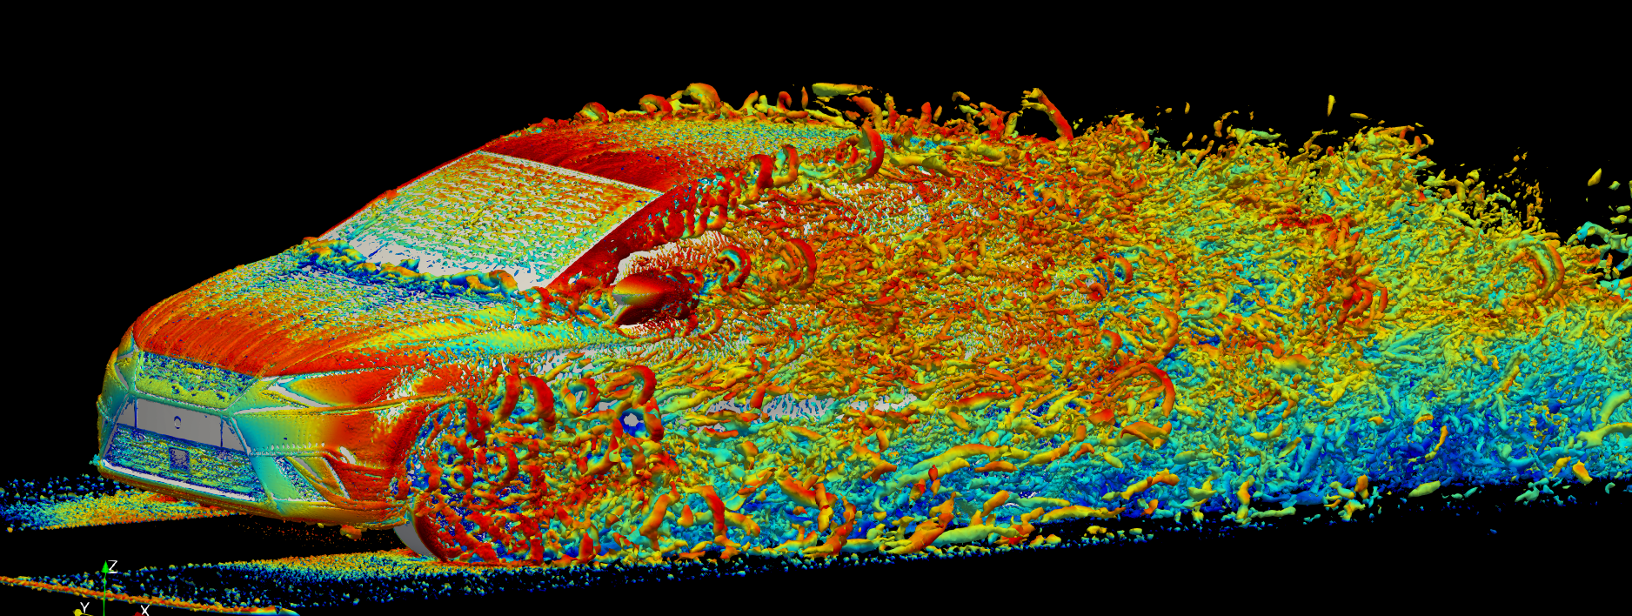
Navier-Stokes equations
https://www.bsc.es/discover-bsc/organisation/research-departments/large-scale-computational-fluid-dynamics

Slide 12

Forward and Inverse ODE/PDE problems
$$N_{x}\left[u\left(x\right)\right]=f,x∈Ω$$
$$B_{x}\left[u\left(x\right)\right]=b, x∈Γ$$
Forward problems: Solve equations given boundary/initial conditions

Slide 13
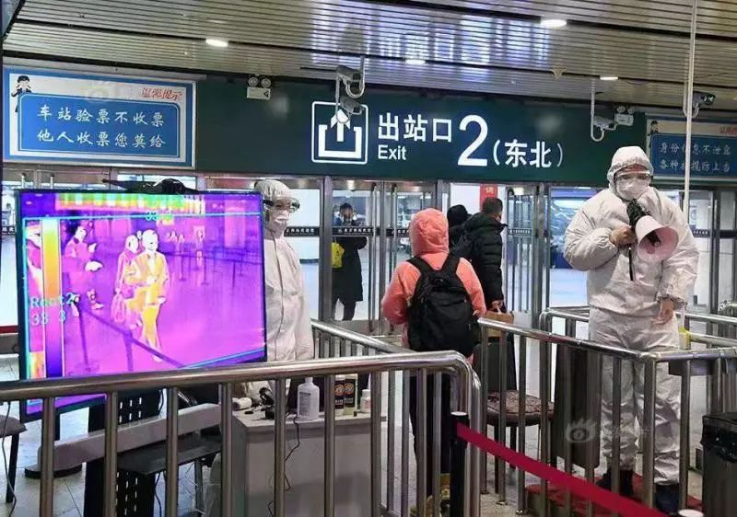
Inverse PDE problems

Slide 14
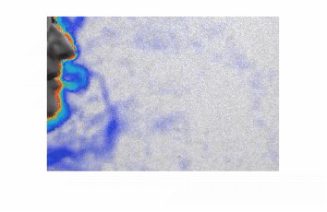
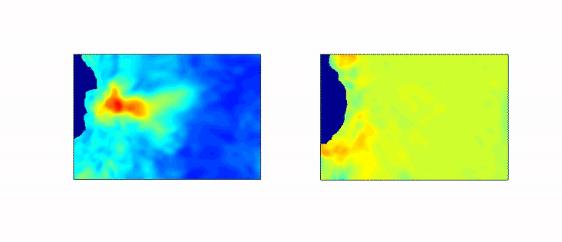
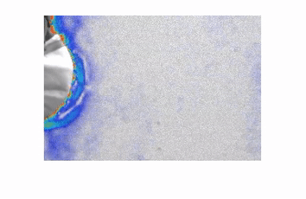
Inverse PDE problems
Does Mask matter: https://www.youtube.com/watch?v=kYJvU81DKgk
Cai et al., Gallery of Fluid Motion - APS DFD meeting, 2020

Slide 15

Inverse PDE problems
$$∂_{t}T+u ⋅∇T=α∇^{2}T$$

Slide 16
Contents
Overview on ODEs/PDEs
From DNN to physics-informed neural networks (PINNs)

Slide 17
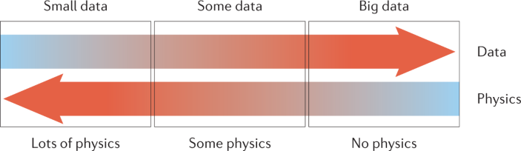
Scientific Machine Learning
Karniadakis, et al, 2021

Slide 18
Conventional numerical solvers for ODEs/PDEs
Finite difference method (FDM)
Finite element method (FEM)
Finite volume method (FVM)
Spectral method (SM)
h-p method
……

Slide 19
Limitations of conventional numerical methods
Mesh generation
High-dimensional problems (Curse of dimensionality)
Solving inverse problems is often prohibitively expensive
Cannot seamlessly incorporate noisy data
…

Slide 20
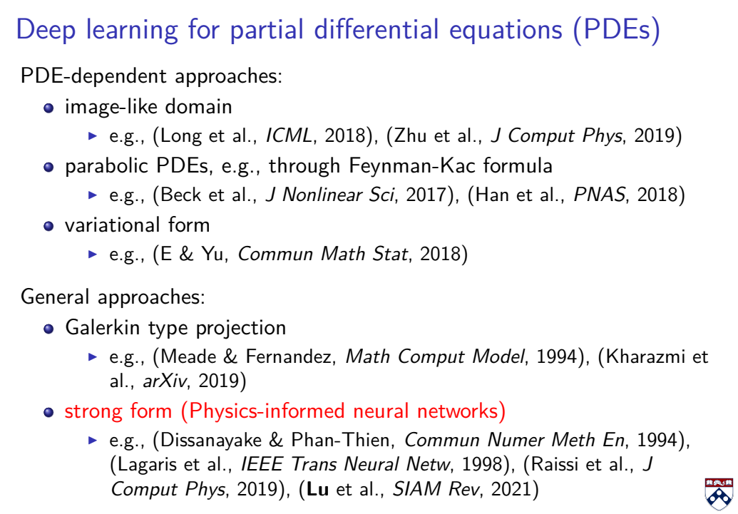
Deep Learning for solving ODEs/PDEs

Slide 21
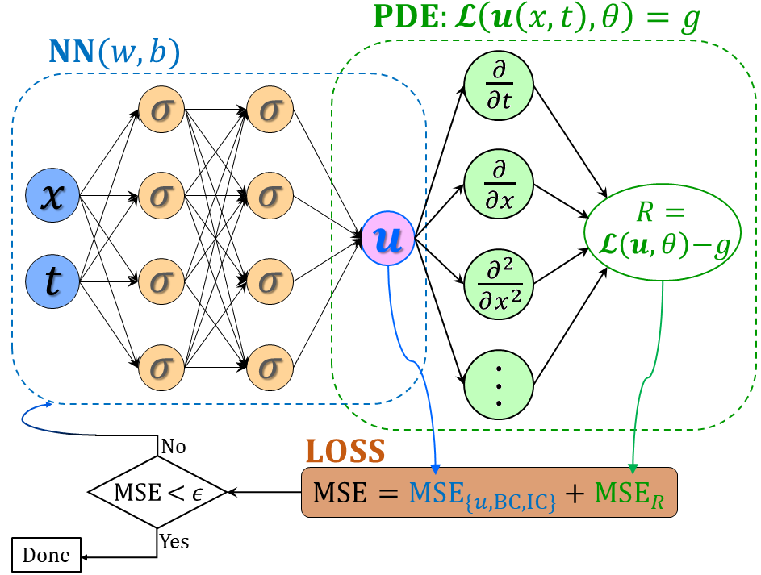
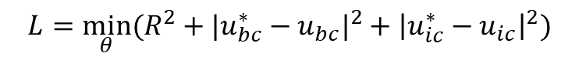

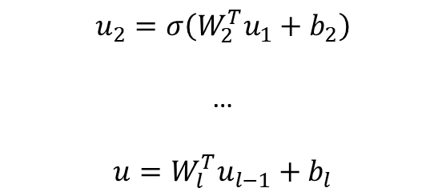

From DNNs to PINNs
$$u_{1}=σ(W_{1}^{T}X+b_{1})$$
(1)
$$u_{2}=σ\left(W_{2}^{T}u_{1}+b_{2}\right)$$
…
$$u=W_{l}^{T}u_{l−1}+b_{l}$$
(2) PDE part: Chain rule
$$∂_{t}u, ∂_{x}u, …$$
Physics-informed neural networks (PINNs)
Loss function:
Forward problem:
$$L={\min_{θ}⁡(R^{2}+|u_{bc}^{∗}−u_{bc}|}^{2}+{\left|u_{ic}^{∗}−u_{ic}\right|}^{2})$$
Inverse problem:
$$L={\min_{θ,λ}⁡(R^{2}+|u_{bc}^{∗}−u_{bc}|}^{2}+{\left|u_{ic}^{∗}−u_{ic}\right|}^{2}+{\left|u^{∗}−u\right|}^{2})$$
Raissi, et al, JCP, 2019
Meng, et al, CMAME, 2020

Slide 22
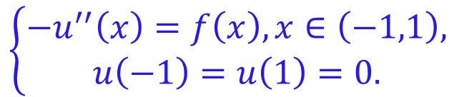

Forward problems: Poisson equation
Consider the 1D Poisson equation with homogeneous boundary conditions
$$\left\{\begin{aligned}−u^{′′}\left(x\right)=f\left(x\right), x∈\left(−1,1\right), \\ u\left(−1\right)=u\left(1\right)=0. \end{aligned}\right.$$
Let $f\left(x\right)=π^{2}\sin\left(πx\right),$ then
$$u\left(x\right)=\sin\left(πx\right).$$

Slide 23
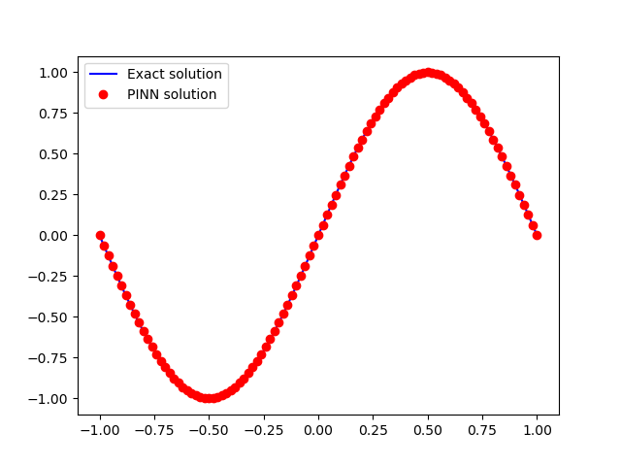
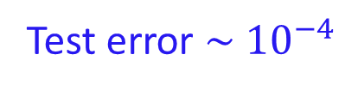
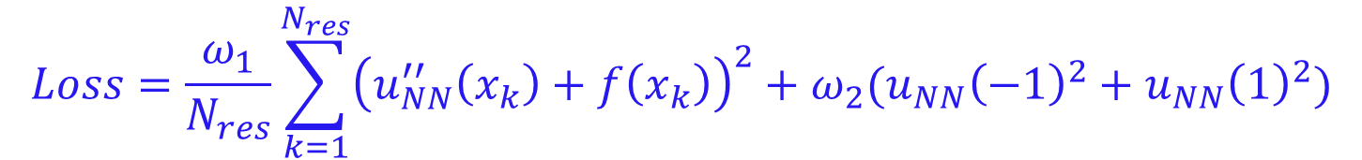
Forward problems: Poisson equation
Loss function
$$Loss=\frac{ω_{1}}{N_{res}}\sum_{k=1}^{N_{res}}{{\left(u_{NN}^{′′}\left(x_{k}\right)+f\left(x_{k}\right)\right)}^{2}}+ω_{2}(u_{NN}{\left(−1\right)}^{2}+u_{NN}{\left(1\right)}^{2})$$
$$ω_{1}=ω_{2}=1$$
Test error $\sim {10}^{−4}$

Slide 24
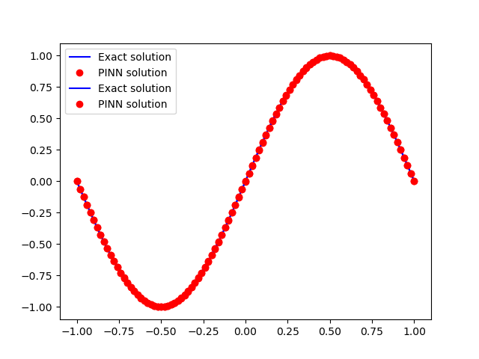
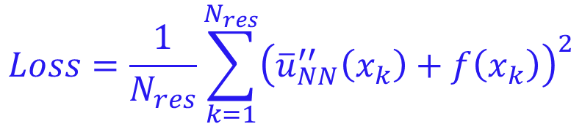
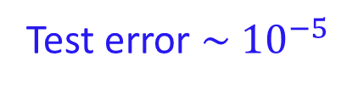
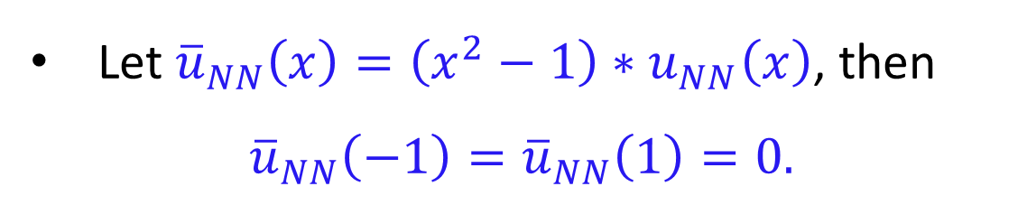
Forward problems: Poisson equation
Let ${{\overline{u}}_{NN}\left(x\right)=\left(x^{2}−1\right)∗u}_{NN}\left(x\right)$, then
$${\overline{u}}_{NN}\left(−1\right)={\overline{u}}_{NN}\left(1\right)=0.$$
$$Loss=\frac{1}{N_{res}}\sum_{k=1}^{N_{res}}{{\left({\overline{u}}_{NN}^{′′}\left(x_{k}\right)+f\left(x_{k}\right)\right)}^{2}}$$
Loss function
Test error $\sim {10}^{−5}$

Slide 25
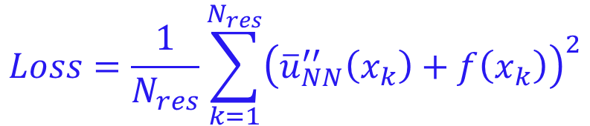
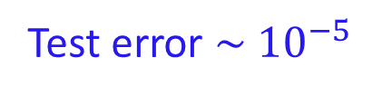
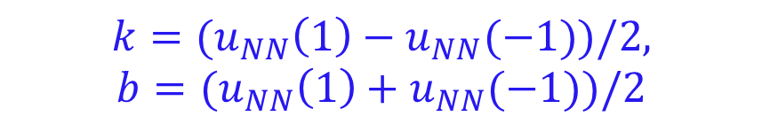
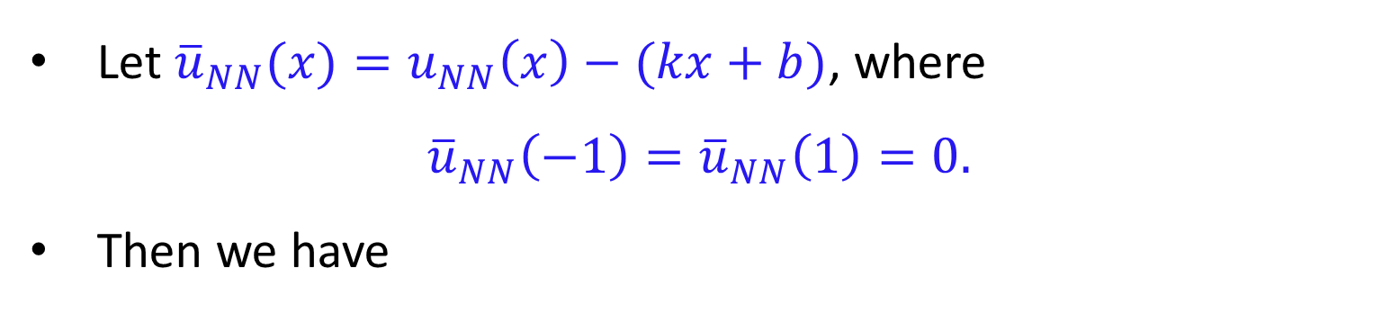
Forward problems: Poisson equation
Let ${{\overline{u}}_{NN}(x)=u}_{NN}\left(x\right)−(kx+b)$, where
$${\overline{u}}_{NN}\left(−1\right)={\overline{u}}_{NN}\left(1\right)=0.$$
Then we have
$$k={(u}_{NN}\left(1\right)−u_{NN}(−1))/2,$$
$$b={(u}_{NN}\left(1\right)+u_{NN}(−1))/2$$
$$Loss=\frac{1}{N_{res}}\sum_{k=1}^{N_{res}}{{\left({\overline{u}}_{NN}^{′′}\left(x_{k}\right)+f\left(x_{k}\right)\right)}^{2}}$$
Loss function
Test error $\sim {10}^{−5}$

Slide 26
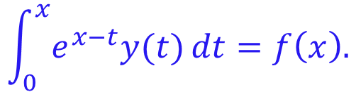

Forward problems: Integral equation
Consider the integral equation
$$\int_{0}^{x}{e^{x−t}y(t)}dt=f\left(x\right).$$
Let $f\left(x\right)=−2sh\left(x\right)=e^{−x}−e^{x},$ then
$$u\left(x\right)=−2e^{−x}.$$
Automatic differentiation is not available, using numerical integration.

Slide 27
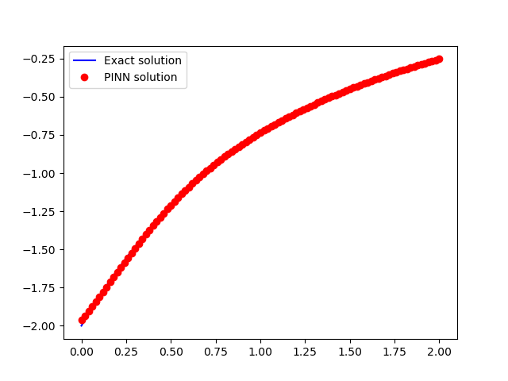
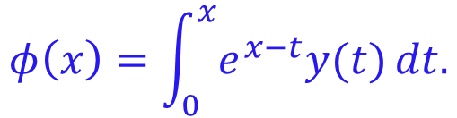
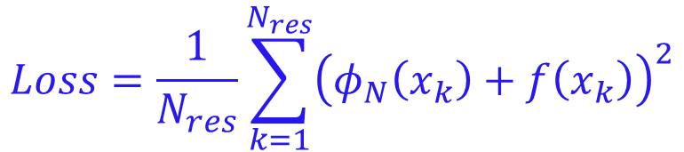
Forward problems: Integral equation
$$φ\left(x\right)=\int_{0}^{x}{e^{x−t}y(t)}dt.$$
Let
$$Loss=\frac{1}{N_{res}}\sum_{k=1}^{N_{res}}{{\left(φ_{N}\left(x_{k}\right)+f\left(x_{k}\right)\right)}^{2}}$$
where $φ_{N}(x)$ is the numerical integration of $φ\left(x\right)$

Slide 28
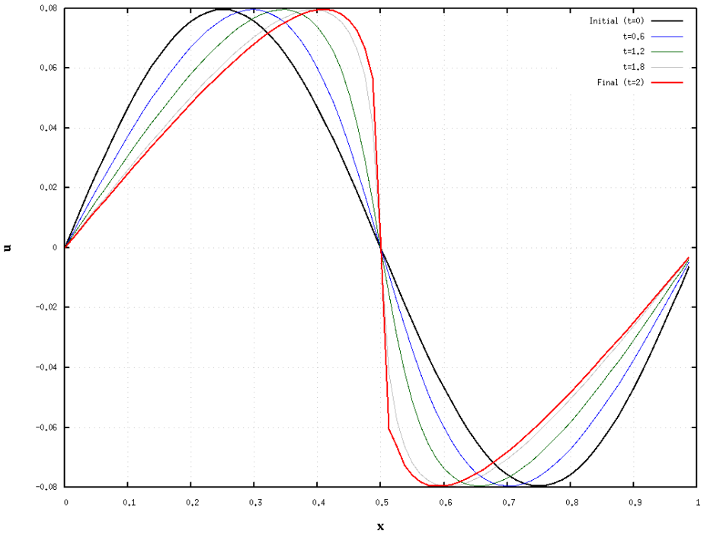
Forward problems: Burgers equation
Consider the following Burgers equation
$$u_{t}+uu_{x}=νu_{xx},x∈\left(−1,1\right), t∈\left(0,T\right],$$
$$u\left(x,0\right)=u_{0}\left(x\right), u\left(−1,t\right)=u\left(1,t\right)=0.$$
Let $u_{0}\left(x\right)=−sin⁡(πx)$

Slide 29
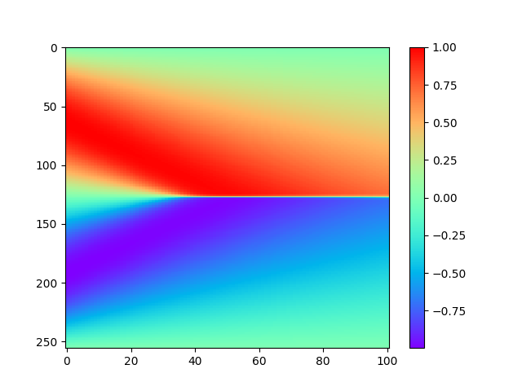
Forward problems: Burgers equation
Consider the following Burgers equation
$$u_{t}+uu_{x}=νu_{xx},x∈\left(−1,1\right), t∈\left(0,T\right],$$
$$u\left(x,0\right)=u_{0}\left(x\right), u\left(−1,t\right)=u\left(1,t\right)=0.$$
Let $u_{0}\left(x\right)=−sin⁡(πx)$

Slide 30
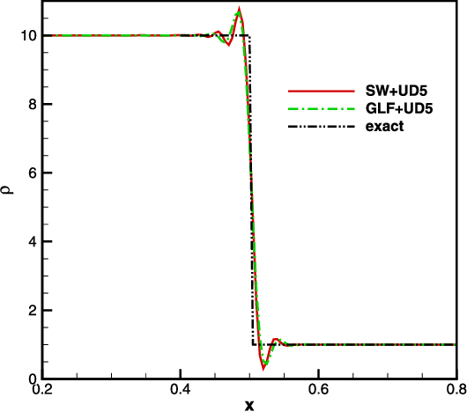
Forward problems: Burgers equation
Consider the following Burgers equation
$$u_{t}+uu_{x}=νu_{xx},x∈\left(−1,1\right), t∈\left(0,T\right],$$
$$u\left(x,0\right)=u_{0}\left(x\right), u\left(−1,t\right)=u\left(1,t\right)=0.$$
Let $u_{0}\left(x\right)=−sin⁡(πx)$

Slide 31
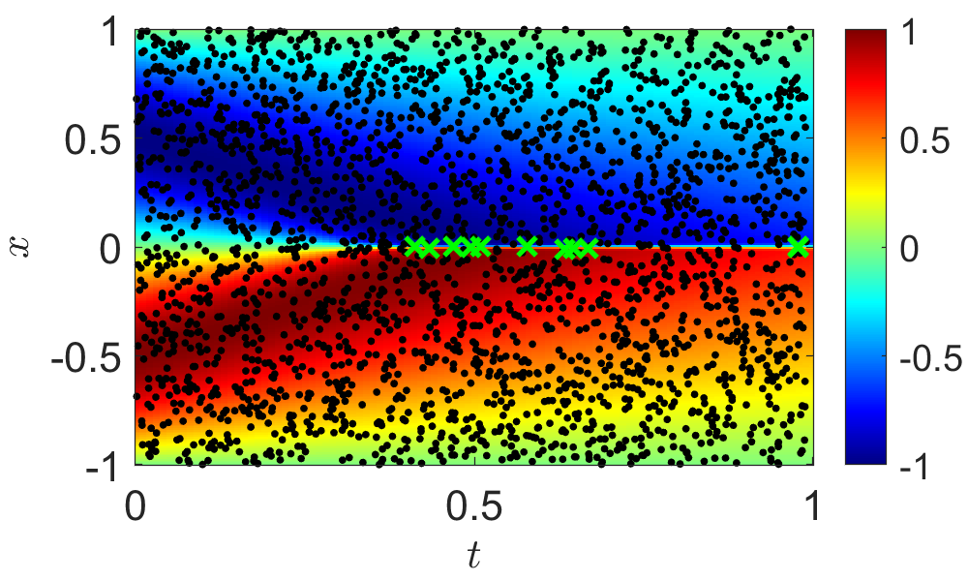
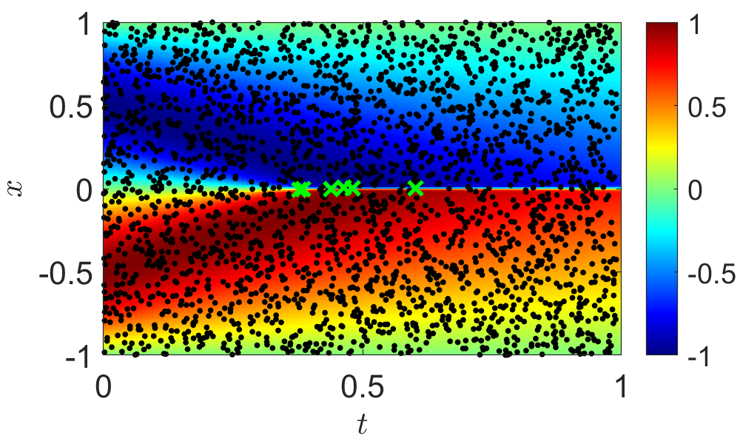
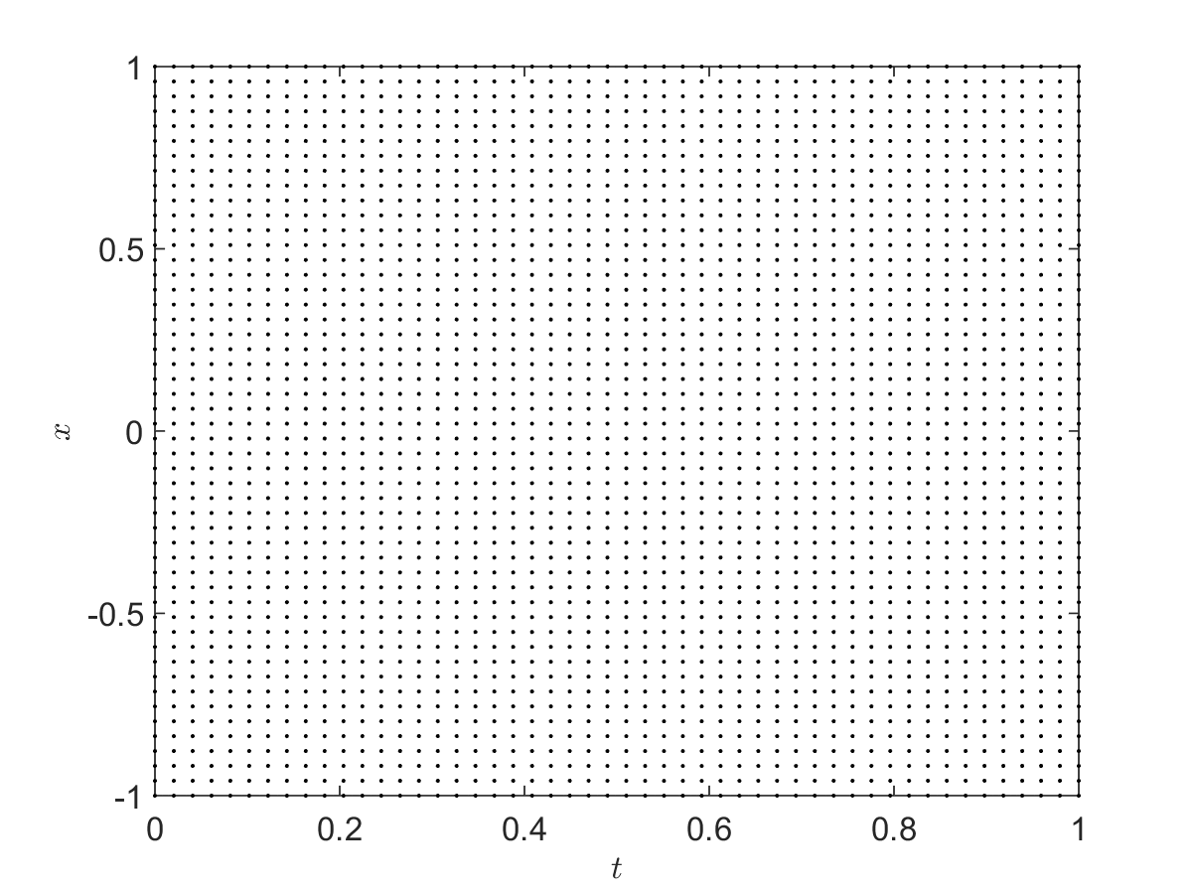
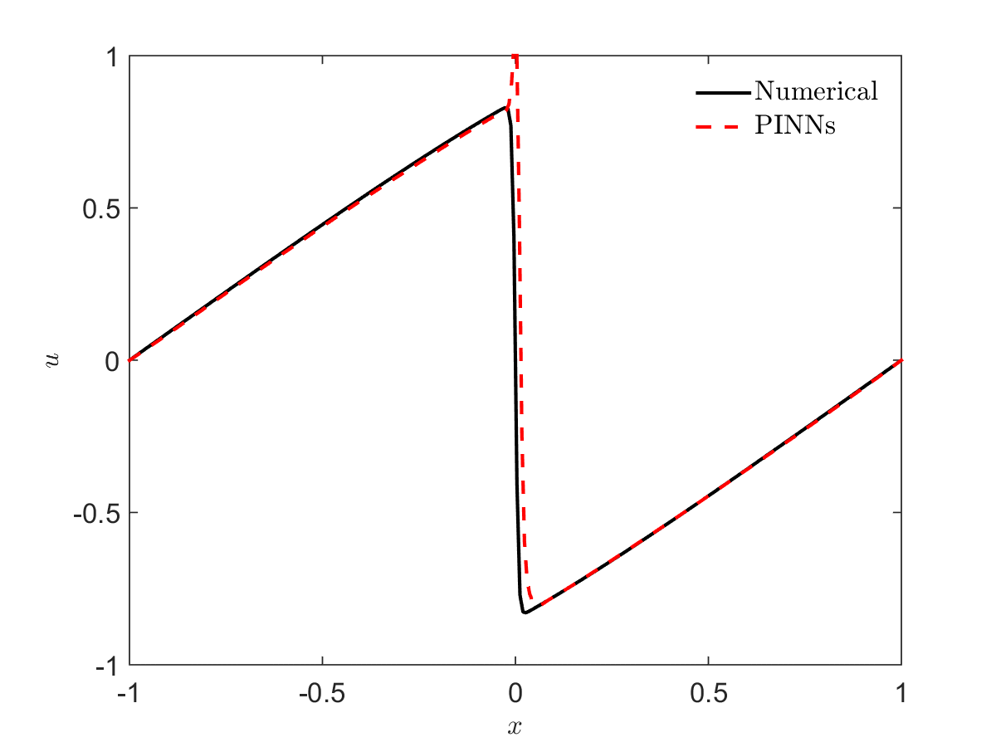
Forward problems: Burgers equation
Lu, et al, SIREV, 2021

Slide 32

Thank you for your attention!

